Slide 1
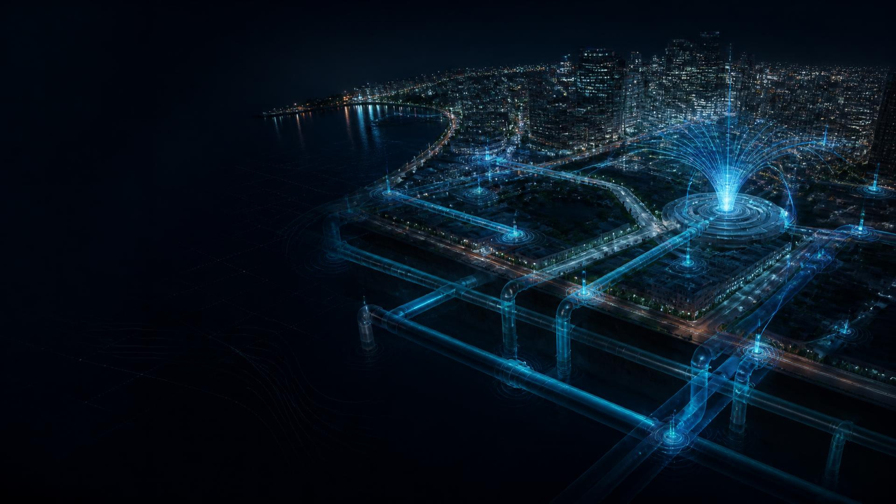
IBM BOB AI HACKATHON
FLOWGEN
AI-powered protection
for every drop.
SENSOR DATA → AI → INTELLIGENCE → ACTION

Slide 2

FLOWGEN / 02
The Hidden Crisis
Beneath Our Cities
TREATED WATER
Undetected underground bursts waste treated drinking water and impose major costs.
WATER QUALITY
Localized chemical, metal, or bacterial contamination can remain unseen until citizens are affected.
CORE PAIN
No unified real-time view of pressure, flow, quality, and location.

Slide 3
FLOWGEN / 03
Why Current Monitoring Isn't Enough
Data exists. Intelligence remains disconnected.
PERIODIC
TESTING
Underground leaks remain invisible
“The challenge is not simply detecting an abnormal reading. It is understanding how multiple signals connect to the same incident.”
MANUAL
INSPECTION
Quality monitoring is intermittent
Pressure, flow, and quality are hard to correlate
CUSTOMER
COMPLAINT
Operators investigate signals manually
INVESTIGATION
RESPONSE

Slide 4
FLOWGEN / 04
Meet Flowgen
From raw sensor data to actionable intelligence.
SENSORS
AI ANALYSIS
ANOMALY +
CONTAMINATION
RISK LOCATION
ACTIONABLE ALERT
OPERATOR RESPONSE
Flowgen combines real-time sensor data, machine-learning anomaly detection, contamination analysis, GIS-based risk mapping, and predictive maintenance in one operator-ready system.

Slide 5
FLOWGEN / 05
Five Intelligence Layers
REAL-TIME ANOMALY DETECTION
GIS-BASED RISK MAPPING
Continuously monitors pressure, flow, and water quality.
FLOWGEN
AI CORE
Maps pipeline zones and downstream impact areas.
CONTAMINATION CLASSIFICATION
PREDICTIVE MAINTENANCE
Identifies abnormal water-quality patterns and risks.
Flags higher-risk infrastructure for earlier attention.
SMART ALERTS
Prioritizes events and response recommendations.

Slide 6
FLOWGEN / 06
How Flowgen Works
Continuous data → AI reasoning → location-aware intelligence → action
WATER NETWORK
IoT / SENSOR DATA
PRESSURE + FLOW
+ WATER QUALITY
FLOWGEN AI ENGINE
ANOMALY DETECTION
CONTAMINATION ANALYSIS
SENSOR FUSION
RISK SCORING
PREDICTION
GIS / RISK MAP
OPERATOR DASHBOARD
PRIORITIZED ALERT
ACTION

Slide 7
FLOWGEN / 07
From Detection to Decision
Reserved for verified project UI — no fabricated screenshots.
01 DASHBOARD / NETWORK OVERVIEW
02 INCIDENT / ANOMALY DETECTION
03 GIS / RISK VISUALIZATION
04 ALERT / RECOMMENDATION
DETECT → UNDERSTAND → LOCATE → PRIORITIZE → ACT

Slide 8
FLOWGEN / 08
IBM Powers the Intelligence Layer
IBM Cloud
Cloud infrastructure + scalable services
watsonx.ai
AI analysis / intelligence
IBM App Connect
Data / service integration
FLOWGEN
SENSOR + NETWORK DATA
OPERATOR
INTELLIGENCE
IBM Bob
AI-assisted interaction + workflow
IBM Instana
Application monitoring
Confirmed implementation roles only

Slide 9
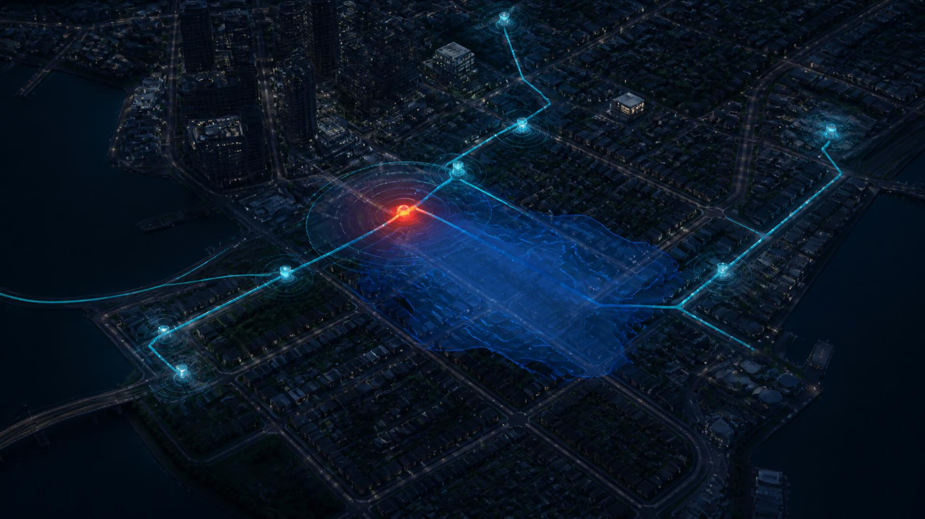
FLOWGEN / 09
Flowgen in a City
1 DETECT unusual sensor behavior
2 CORRELATE multiple signals
3 ANALYZE incident pattern
4 LOCATE geographic zone
5 ASSESS RISK downstream areas
6 ALERT prioritized warning
7 RESPOND faster intervention

Slide 10
FLOWGEN / 10
Turning Water Data Into Real-World Impact
Prototype capabilities and responsible future value — without unverified guarantees.
REDUCE AVOIDABLE WATER LOSS
FASTER AWARENESS
WATER QUALITY INTELLIGENCE
Earlier identification of pipeline incidents
Continuous signals support earlier warning
Detect abnormal quality patterns
LOCATION-AWARE RESPONSE
SMARTER MAINTENANCE
SMARTER CITIES
Connect incidents with geographic risk
Support data-driven prioritization
Advance intelligent network management

Slide 11
FLOWGEN / 11
More Than Leak Detection
TRADITIONAL APPROACH
FLOWGEN
— Periodic monitoring
+ Continuous monitoring
— Individual sensor readings
+ Multi-signal analysis
— Manual investigation
+ AI-assisted investigation
— Reactive response
+ Predictive risk analysis
+ Unified intelligence
— Disconnected information
+ Location-aware alerts
Flowgen connects infrastructure health and water quality into one intelligent decision system.
FUTURE POTENTIAL • Wider sensor deployment • Advanced predictive models • Automated emergency workflows • Municipal-system integration • Smart-city expansion

Slide 12
FLOWGEN
AI-powered protection for every drop.
DETECT THE HIDDEN.
UNDERSTAND THE RISK.
PROTECT THE NETWORK.
PROTECT THE PEOPLE.
SENSOR DATA → AI → INTELLIGENCE → ACTION
IBM Bob AI Hackathon

